Slide 1
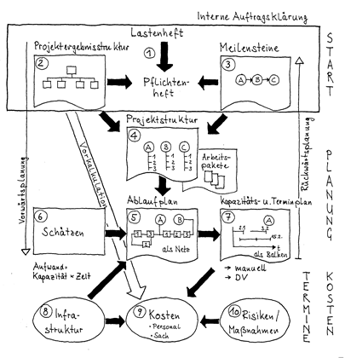
Project name
Kick-off meeting
Picture of the Project
student 1, student 2, student 3…...
Darmstadt, dd.mm.yy

Slide 2
Content
  Team
  State of the art
  Challenges
  Targets
  Project schedule
  Next steps
Project Management | Prof. Dr.-Ing. P. Fromm | University of Applied Sciences Darmstadt

Slide 3
Team
Project leader
  Student 1
  Team members
  Student 2 -> responsibility
  Student 3 -> responsibility
  Student 4 -> responsibility
  Student 5 -> responsibility
  …..
Project Management | Prof. Dr.-Ing. P. Fromm | University of Applied Sciences Darmstadt

Slide 4
State of the art (SoA)
  Current situation…….
  …..
Project Management | Prof. Dr.-Ing. P. Fromm | University of Applied Sciences Darmstadt

Slide 5
Overview
  Provide a block diagram or another high level description of your project
  …….
Project Management | Prof. Dr.-Ing. P. Fromm | University of Applied Sciences Darmstadt

Slide 6
Targets
In scope
  Project targets (Functional and non-functional, e.g. quality)
  …….
  …..
Out of scope
  Issue out of scope
Project Management | Prof. Dr.-Ing. P. Fromm | University of Applied Sciences Darmstadt

Slide 7
Project schedule
  Work packages / time / responsibility
  Use a copy of the provided Excel sheet
  …..
Project Management | Prof. Dr.-Ing. P. Fromm | University of Applied Sciences Darmstadt

Slide 8
Next steps
  Next steps / time / responsibility
  …….
  …..
Project Management | Prof. Dr.-Ing. P. Fromm | University of Applied Sciences Darmstadt

